Slide 1
UML Data Modeling
Dr. Shaheen Khatoon
Application
program
DBMS
End-user
1-<number>

Slide 2


Data Modeling
How to represent data for application
Relational model − with design principles
XML
Database design model
  Not implemented by system
  Translated into model of DBMS
Higher-level model
Translator
Relations
RDBMS

Slide 3
Data Modeling
Higher-Level Database Design Models
  Entity-Relationship Model (E/R)
  Unified Modeling Language (UML)
    Data modeling subset
  Both are graphical
  Both can be translated to relations automatically
    Or semi-automatically

Slide 4
UML Data Modeling: 5 concepts
  Classes
  Associations
  Association Classes
  Subclasses
  Composition & Aggregation

Slide 5
UML Data Modeling: Classes
Name, attributes, methods
For data modeling: add “pk”, drop methods
Student
SID PK SName GPA
<Methods>
College
CName PK State
<Methods>

Slide 6
UML Data Modeling: Associations
Relationships between objects of two classes
Student
SID PK SName GPA
<Methods>
College
CName PK State
<Methods>
Applied

Slide 7
Multiplicity of Associations
Relationships between objects of two classes
Each object of class C₁ is related to at least m and at most n objects of class C₂
C1
C2
m .. *
x..y
A
m..n
0 .. n
0 .. *
m
.
.
n
Default
1 .. 1 -> 1

Slide 8
Multiplicity of Associations: Example
Students must apply somewhere and may not apply to more than 5 colleges. No college takes more than 20,000 applications.
Student
SID PK SName GPA
<Methods>
College
CName PK State
<Methods>
0 .. 20,000
1 .. 5
Applied

Slide 9
Multiplicity of Associations:
Types of Relationships
One-to-One
Many-to-One
Many-to-Many
Complete
C1
0 .. 1
C2
0 .. 1
*
0 .. 1
*
*
Complete One-to-One
1..1
1..1
Complete Many-to-One
1..*
1..1
Complete Many-to-Many
1..*
1..*

Slide 10
UML Data Modeling: 5 concepts
  Classes
  Associations
  Association Classes
  Subclasses
  Composition & Aggregation

Slide 11
UML Data Modeling: Association Classes
Relationships between objects of two classes,
with attributes on relationships
Student
SID PK SName GPA
<Methods>
College
CName PK State
<Methods>
Applied
AppInfo
Date Decision
<Methods>

Slide 12
Eliminating Association Classes
Unnecessary if 0..1 or 1..1 multiplicity
Student
SID Sname GPA
*
1..1
College
CName State
Applied
0..1
AppInfo
Date Decision

Slide 13
Eliminating Association Classes
Unnecessary if 0..1 or 1..1 multiplicity
Student
SID SName GPA DateApplied Decision
*
1..1
College
CName State
Applied
0..1

Slide 14
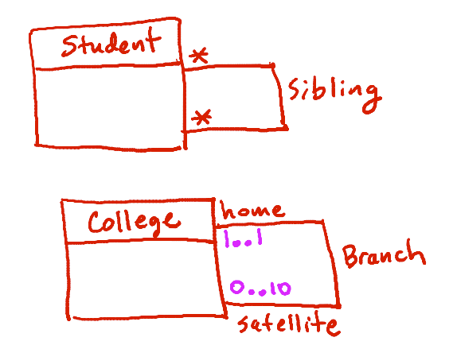
Self-Associations
Associations between a class and itself

Slide 15
UML Data Modeling: 5 concepts
  Classes
  Associations
  Association Classes
  Subclasses
  Composition & Aggregation

Slide 16
UML Data Modeling: Subclasses
Student
SID PK SName GPA
<Methods>
Super class
APInfo
Year Grade
ForeignS
Country
DomesticS
State SSN
AP
APCourses
courseNo PK Title
1..*
1..10
Took
Sub classes

Slide 17
Subclass Terminology & Properties
Superclass = Generalization
Subclass = Specialization
Incomplete (Partial) vs. Complete
  Complete if every object in the superclass is in at least one subclass, otherwise incomplete
Disjoint (Exclusive) vs. Overlapping
  disjoint if every object is in at most one subclass (we don't have any objects that are in more than one subclass, and that's sometimes called exclusive)

Slide 18
UML Data Modeling: Subclasses
Student
SID PK SName GPA
<Methods>
APInfo
Year Grade
{ Complete,
Overlapping}
DomesticS
State SSN
1..*
1..10
APCourses
courseNo PK Title
ForeignS
Country
AP
Took

Slide 19
UML Data Modeling: Subclasses
Student
SID PK SName GPA
<Methods>
{ Complete,
Disjoint}
ForeignS
Country
DomesticS
State SSN

Slide 20
UML Data Modeling: Subclasses
Student
SID PK SName GPA
<Methods>
{ Incomplete}
APCourses
courseNo PK Title
1..*
1..10
APInfo
Year Grade
Took

Slide 21
UML Data Modeling: 5 concepts
  Classes
  Associations
  Association Classes
  Subclasses
  Composition & Aggregation

Slide 22
UML Data Modeling:
Composition & Aggregation
Objects of one class belong to objects of another class
College
Cname PK State
<Methods>
Department
dname building
<Methods>
1..1

Slide 23
UML Data Modeling:
Composition & Aggregation
Objects of one class belong to objects of another class
College
Cname PK State
<Methods>
Apartment
Address PK #units
<Methods>
0..1

Slide 24
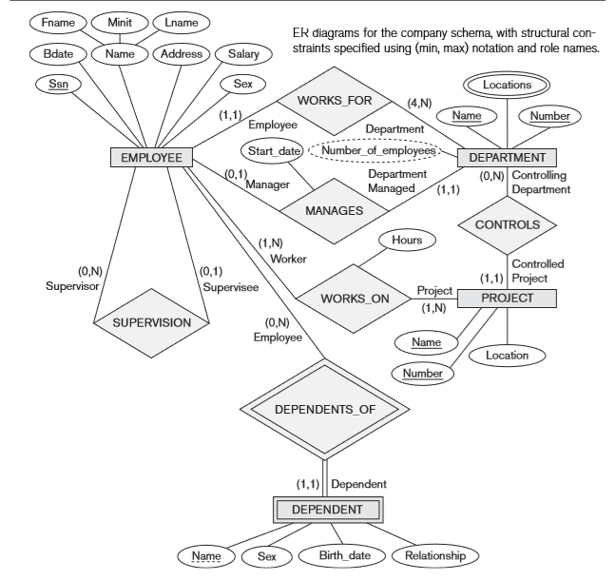
Practice: Map ER to Object Model

Slide 25
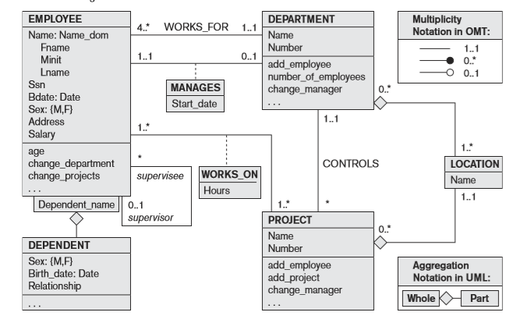
The COMPANY conceptual schema in UML class diagram notation

Slide 26
Homework
Draw a UML diagram for the following scenario:
Consider a tiny social network containing high school students and their “friendship“. Each student may have a friend on at most one other student, and associated with each friendship is the length of time the friendship has been going on. Students have a name and a grade, and names are unique. Draw a UML diagram that models this information. Make sure to capture the asymmetry and multiplicity of the friendship relationship.
1-<number>

Slide 27
Homework: Solution
Student
SName PK Grade
HasFriend
FriendInfo
Length-of-time
*
0..1
Friendship
1-<number>

Slide 28
Summary
Higher-Level Database Design
  Unified Modeling Language (UML)
    Data modeling subset
  Graphical
  5 concepts
    Classes
    Associations
    Association Classes
    Subclasses
    Composition & Aggregation
  Can be translated to relations automatically

